Slide 1
AllianceBernstein Capstone Project
2.22 Weekly Update
Hongyu Dai

Slide 2
Previous takeaway
Web Scraping based on CA DataQuest
Potential fields for 5-year time series analysis, which districts are showing the strongest trend

Slide 3
Quick Summary
CA Web Scraping:
Accomplishment: Scarping code have been completed
Tech Problem: Scraping block because of too frequent visit
TX 5-year trend analysis
In-progress (60%）
Current difficulty: element mapping
Notes:
Input data field, subcategory and data level, locate its elements id

Slide 4
Web Scraping based on CA DataQuest
Combine beautiful soup & selenium
Beautiful Soup: get fundamention information of county/link/..
Selenium:
Analyze website layout,
Achieve human actions like click, submit, drive back
Save as function
Implemented error handling to handle common exceptions and print the corresponding error message and URL of the page.

Slide 5
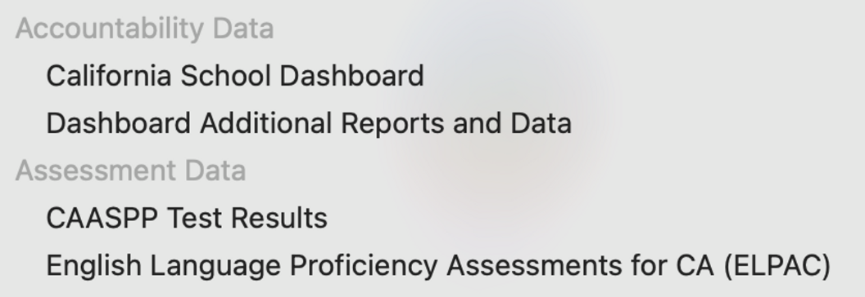
Web Scraping based on CA DataQuest
Problem:
Some field don’t have a standard table format, more like a dashborad
Question:
Do we want those data?
If so, How to organize its form?

Slide 6
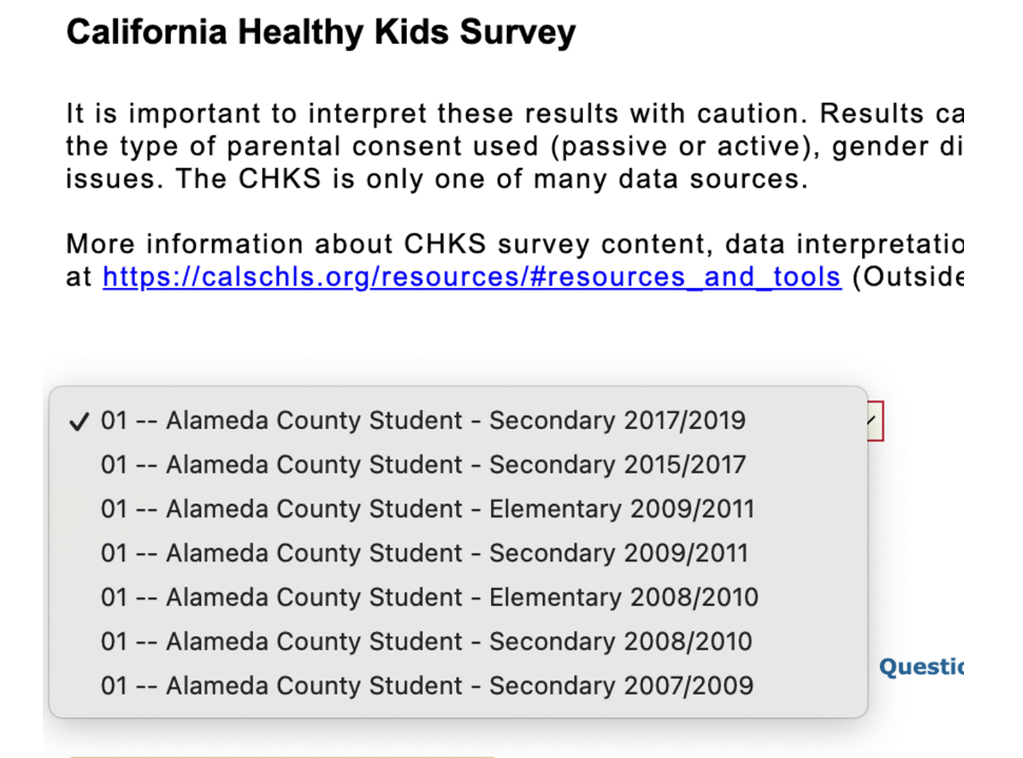
Web Scraping based on CA DataQuest
For field CA Healthy Kid Survey:
Return a pdf around 80-pages
Data is not annual
Every two years

Slide 7
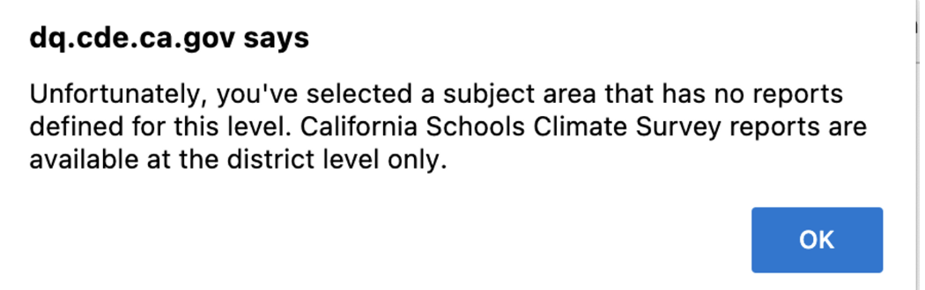
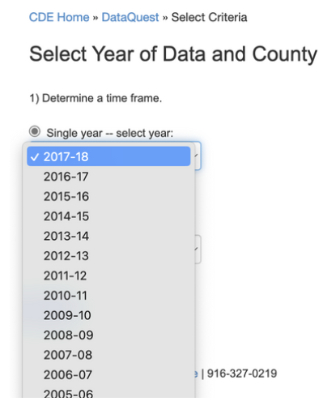
Web Scraping based on CA DataQuest
CA School Staff Survey
Only available at district level
Create your own report
The latest year is 2017-16, more than the last five years

Slide 8
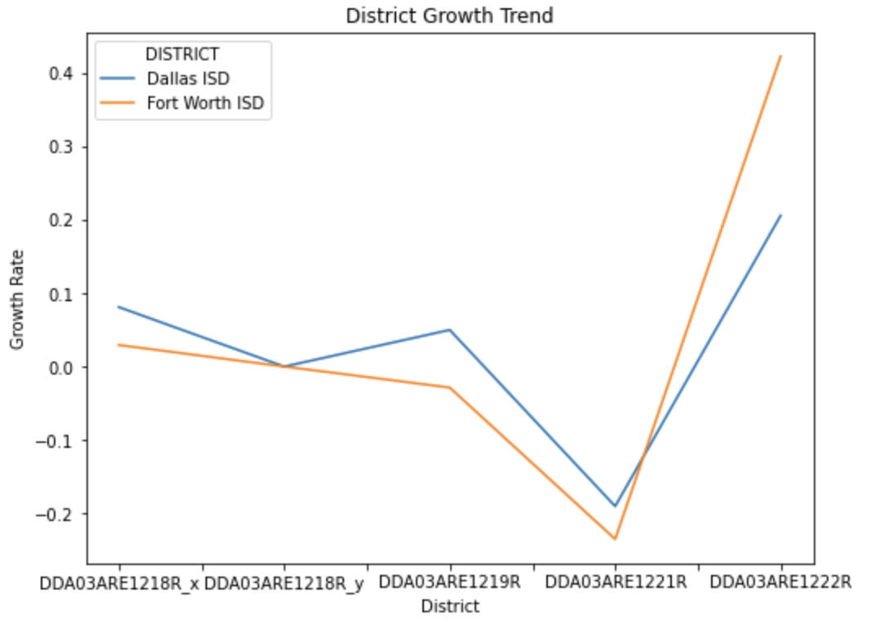
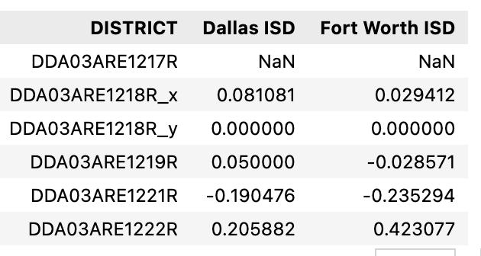
TX 5-years trend analysis
Input district name, locate its district id
Input data field, subcategory and data level, locate its elements id
Still working on
May need to apply Table QA model
Table Mapping
Calculate pct change and plot the trend figure

Slide 9
Next steps
Improve CA web scarping code
Element mapping for TX 5-years trend analysis
TBD

